Slide 1
Melt Spinning
Dr Shama Sadaf
Home Economics Department
Lahore College for Women University Lahore

Slide 2
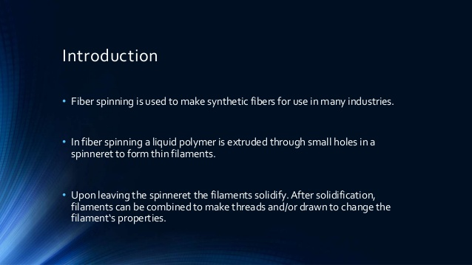
Spinning

Slide 3
Spinning
Spinning is manufacturing process for creating polymer fibers. It is a specialized form of extrusion that uses a spinneret to form multiple continuous filaments.
There are three types of spinning
Wet
Dry
Melt spinning

Slide 4
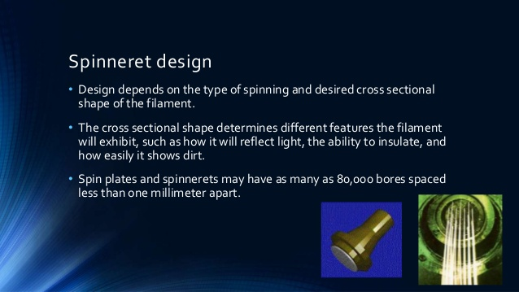

Slide 5
Melt spinning
Melt spinning is the most convenient and economic method for polymer fiber manufacturing at industrial scales.
Melt spun fibers can be extruded from the spinneret in different cross-sectional shapes (round, trilobal, pentagonal, octagonal, and others). Trilobal-shaped fibers reflect more light and give an attractive sparkle to textiles.
Pentagonal-shaped and hollow fibers, when used in carpet, show less soil and dirt. Octagonal-shaped fibers offer glitter-free effects. Hollow fibers trap air, creating insulation and provide loft characteristics equal to, or better than, down.

Slide 6
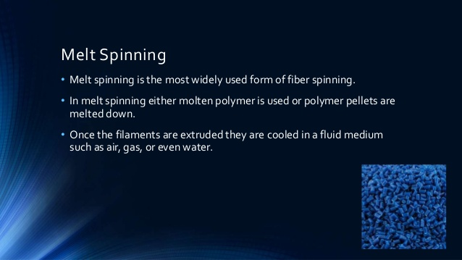

Slide 7
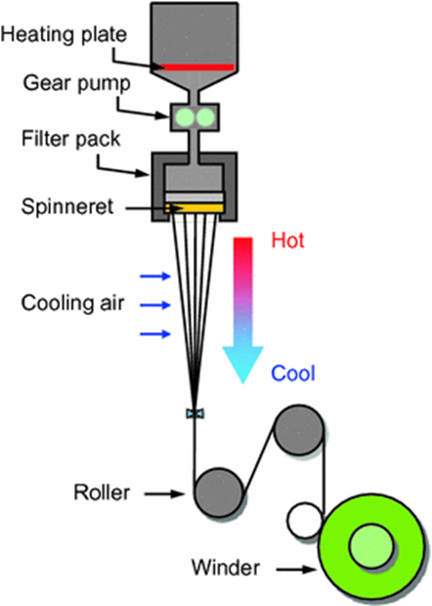
Process
. In melt spinning, the fiber-forming substance is melted for extrusion through the spinneret and then directly solidified by cooling
Finally, spin finish is applied before the filament bundles are wound on tube rolls.

Slide 8
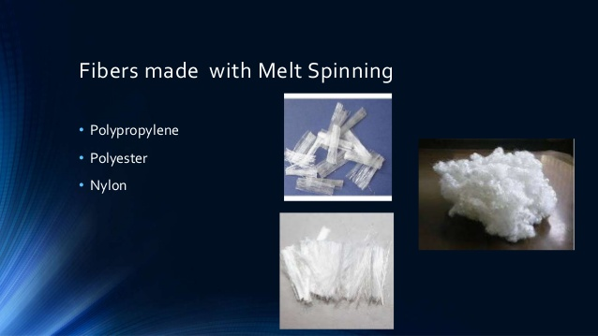

Slide 9
Advantages
Can be used for both staple and continuous filament
No environment pollution
High production speed (2500-3000) ft/min
Low investment cost

Slide 10
Disadvantages
Separate drawing step (unless spin draw)
Necessary high temperature may damage some polymers

